Slide 1
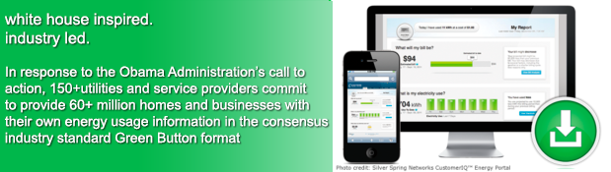
The Green Button Initiative
www.greenbuttondata.org
John Teeter, Presidential Innovation Fellow Alumni,
National Institute of Standards and Technology
john.teeter@nist.gov

Slide 2




Federal Government Interest in Data Access
Open Data Initiatives
Making government information resources more publicly accessible in “computer-readable” form and encouraging its use by entrepreneurs as fuel for the creation of new products, services, and jobs
Project Open Data: http://project-open-data.github.io
Examples: Federal Register 2.0, Data.gov, Health Data Initiative, …
My Data Initiatives
Empowering consumers with secure access to their own personal health, energy, and education data
Blue Button (health info), Green Button (energy), Education, …

Slide 3
US Federal Government Commitment
Climate Action Plan
“The Administration will leverage the ‘Green Button’ standard – which aggregates energy data in a secure, easy to use format – within federal facilities to increase their ability to manage energy consumption, reduce greenhouse gas emissions, and meet sustainability goals.” The President’s Climate Action Plan, June 25, 2013
Presidential Memorandum (to all Federal agencies)
“Sec. 3. Building Performance and Energy Management .. each agency shall: … incorporate Green Button into reporting, data analytics and automation, and processes, in consultation with local utilities …” [.. GSA, EPA pilots …] Presidential Memorandum on Federal Leadership in Energy Management, December 5, 2013

Slide 4
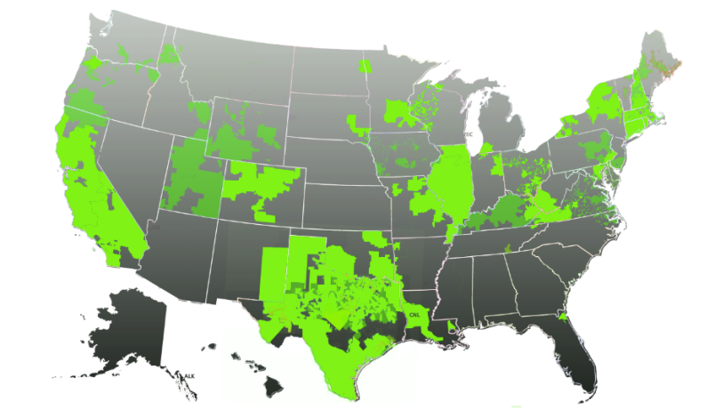
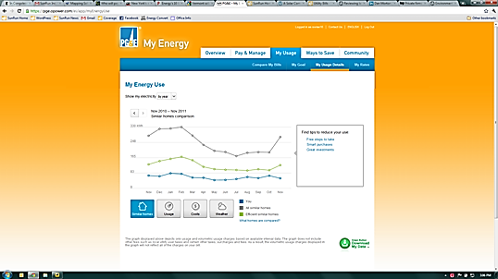


Green Button Across the Nation
Enables electronic consumer access to energy data and supports development of ecosystem (apps)
Available to 60+ million customers in the US and and additional CANADA: 2.6 million+
Result of collaboration among White House, NIST, DOE, state regulators, utilities, vendors, SGIP, and North American Energy Standards Board
Green Button Download My Data and Green Button Connect My Data
Map of US Green Button Commitments

Slide 5
Green Button Download My Data & Connect My Data Now Rolling Out
A customer visits their utility web portal, they can simply login and download their Green Button Data as an XML-formatted file.
This powerful model allows a consumer to authorize a third-party service provider to receive direct access to their Green Button Data - no need to repeatedly login to their utility and download files. These authorizations are valid for an agreed upon time and can be revoked at anytime by the consumer.

Slide 6
Green Button Evolution
White House Call to Action
Connect My Data Beta Deployments
American Energy Data Challenge
Green Button
CMD Certifications
9/2011
NAESB ESPI Standard Ratified
12/2012
11/2013
4Q 2014
HEY Update w/Green Button
Presidential Memorandum to Federal Agencies
10/2011
First DMD
Available
1/2012
DMD Certifications
Green Button CMD Rollouts
Nationally
DOE Apps for Energy
4/2013
12/2013
2H/2014
5/2012
1H/2015
2011
2012
2014
2013
2015
0 Customers
(Download My Data)
12 Million Customer Accounts*
26 Million Customer
Accounts*
42 Million Customer
Accounts*
* Represents Customer Accounts with Access to Green Button Data – Primarily DMD; Actual Customer download numbers are not available
Notes:
1 – DoE Energy-Apps
a) SDG&E and PG&E released their Green Button support within 90 days of the Call to Action
b) DoE sponsored an Apps for Energy challenge to stimulate ecosystem growth
2 – EPA PM Upgrade: EPA release of API moved Portfolio manager to an Open API platform and set the stage for future Green Button support,
the details of which will be reflected in the EPA portion of the agenda (not wanting to steal their thunder.

Slide 7
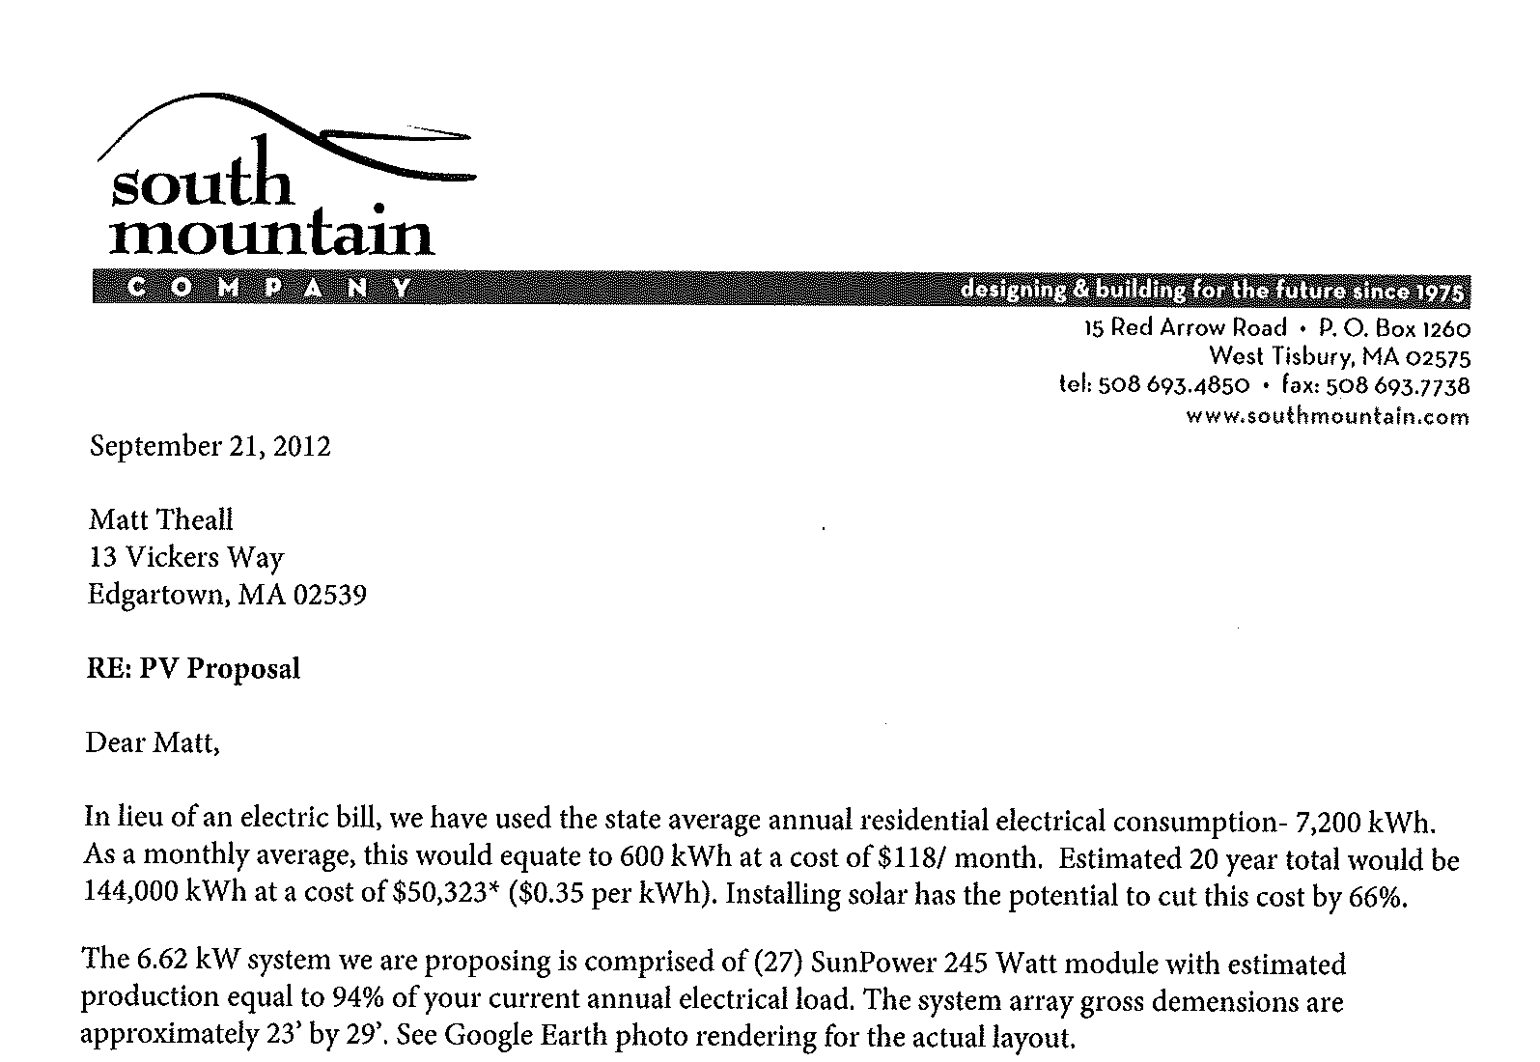


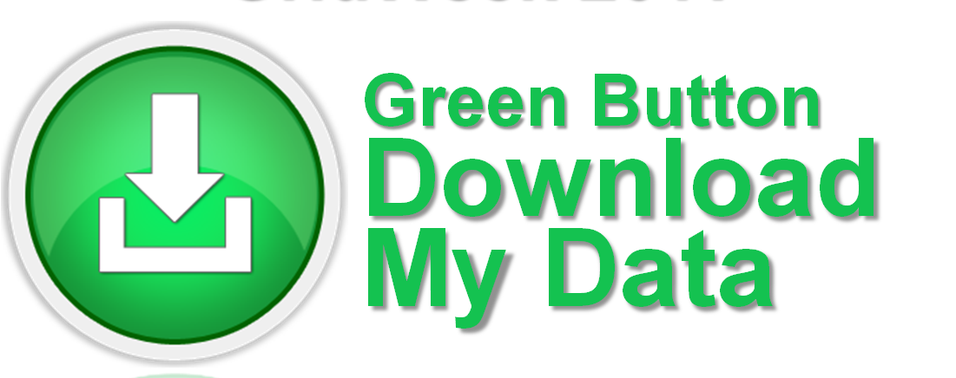
Example use case: solar PV proposal
“Solar companies are also eager for consumer data because understanding a homeowner's electricity use is key to the sales process.” – San Jose Mercury News
Courtesy of Matt Theall, Green Button Presidential Innovation Fellow (DOE)
PV quote based on state average annual electricity consumption (Green Button data not available yet)
Estimated
600 kWh/month
$118/month
Actuals/month
16398/12 = 1366.50 kWh/month
$2,774.04/12 = $231.17/month
Based on Matt’s Green Button Data:
More than 2X Higher Than Estimated!
16,398 x 20yrs = 327,960 kWh @ 0.35 = $114,786

Slide 8




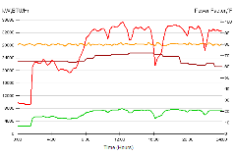
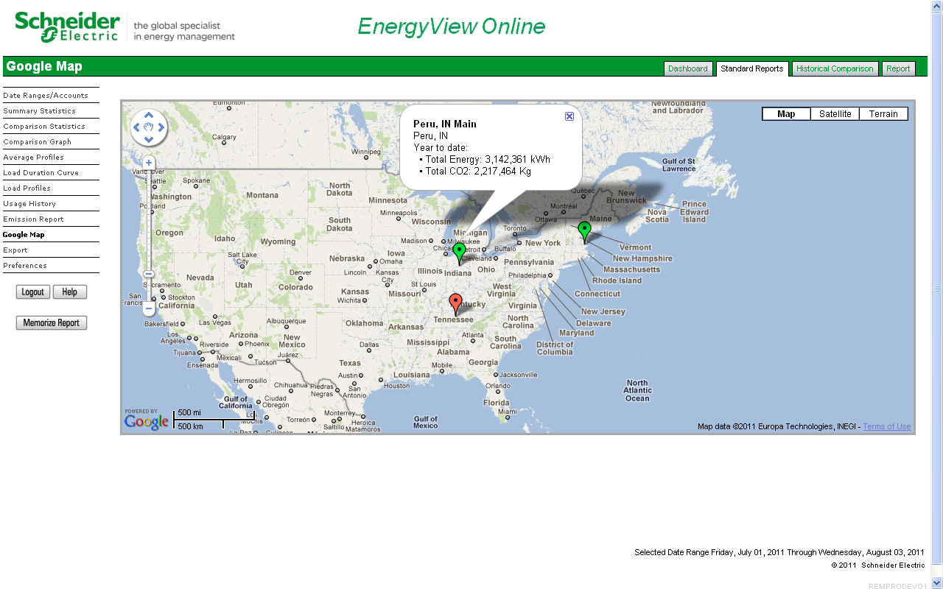

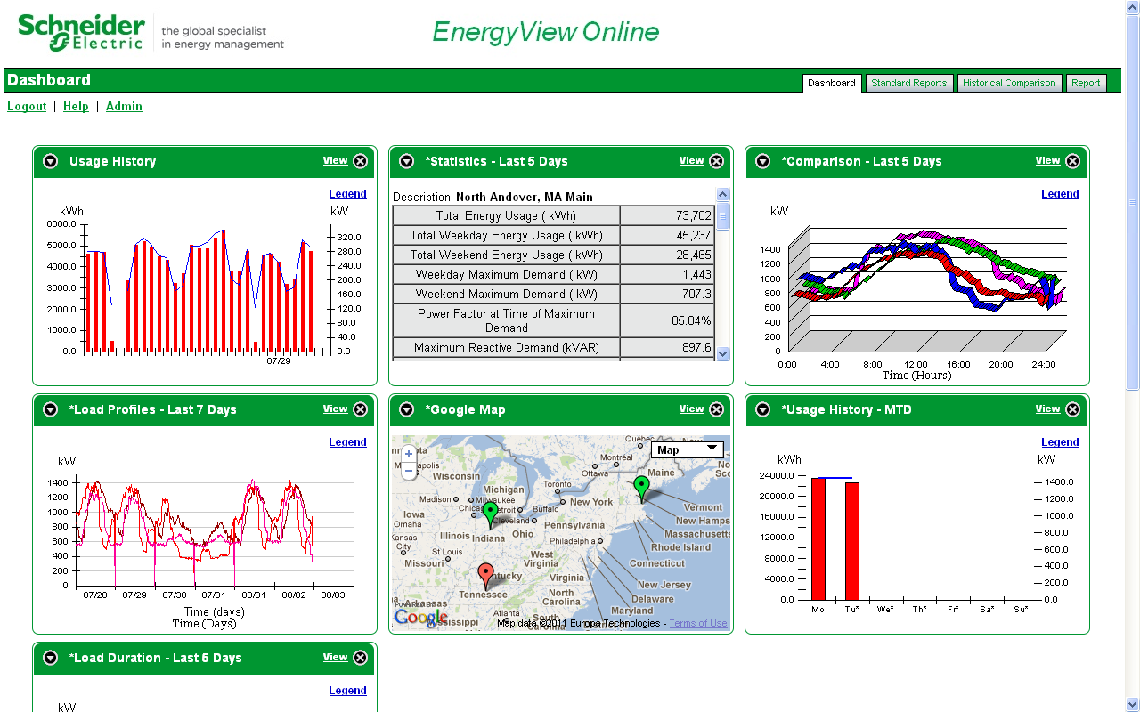

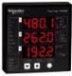
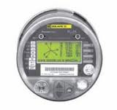

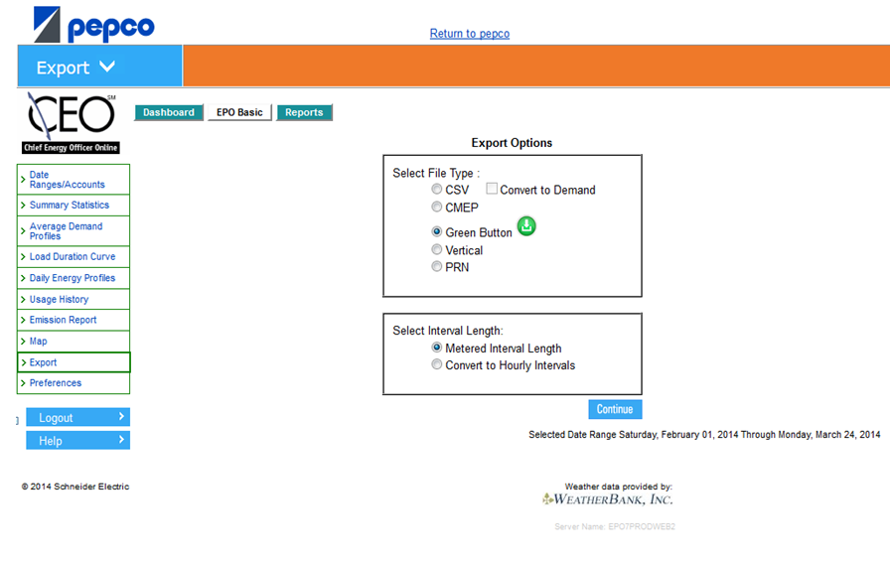
Third Party Vendor Implementation
Schneider Electric
Energy Profiler On-Line
Utility
ISO
Meter Data Management
MV-90
Energy Profiler Online
Loadstar
-Customer engagement
-User portal
-Load profiling
-Energy reporting
-Emissions tracking
-Bill estimation
-DRMS
-Branded utility offer
Sub-Meters
In Buildings
Legacy systems
Near-real time metering

Slide 9
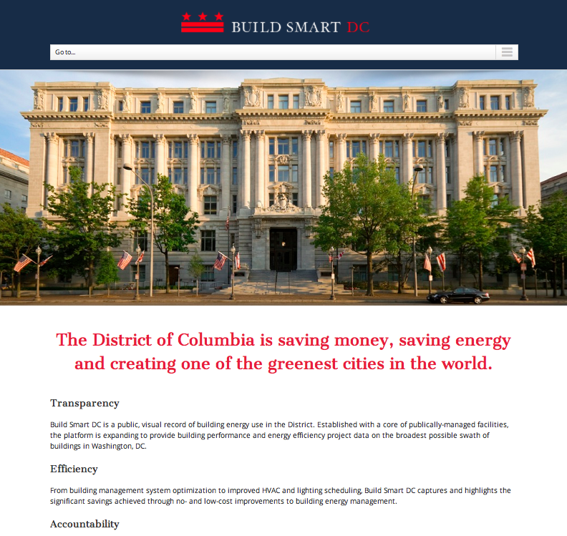
Green Button Connect My Data In Washington DC Governmental Services
Providing 15 Minute
Interval Data for 400+
Buildings in Washington
Local Utility (Pepco)
Providing first in the
Nation deployment with
Green Button Connect
My Data inside!
Available throughout
Pepco Service Area

Slide 10













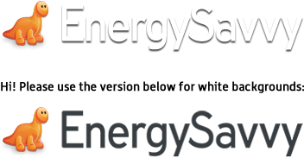






Green Button Supports Innovation in New Applications
Insight: entrepreneur-created web portals analyze energy usage and provide actionable tips;
Heating and Cooling: customized heating and cooling activities for savings and comfort;
Education: community and student energy efficiency competitions;
Retrofits: improved decision-support tools to facilitate energy efficiency retrofits;
Verification: measurement of energy efficiency investments;
Real Estate: provide energy costs for tenants and/or new home purchasers; and
Solar: optimize the size and cost-effectiveness of rooftop solar panels.
www.greenbuttondata.org
Notes:
10

Slide 11

Information for YOU!
Thank You

